Slide 1
Load Balancer & Auto Scaling

Slide 2
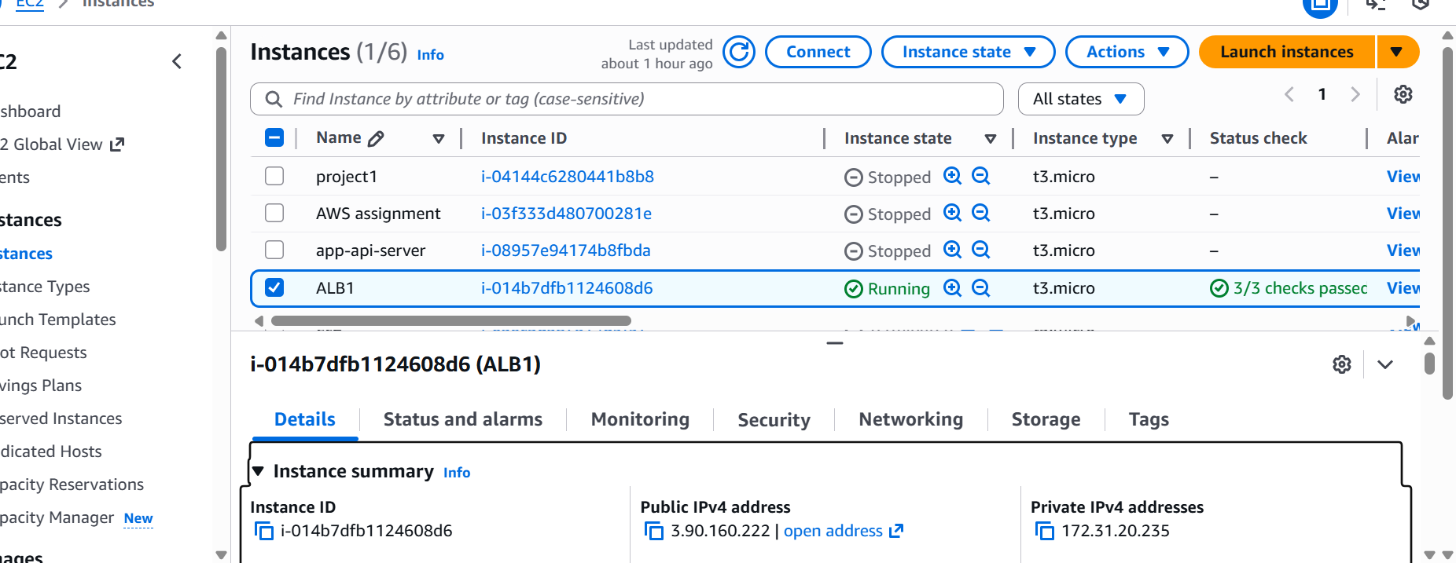

Slide 3
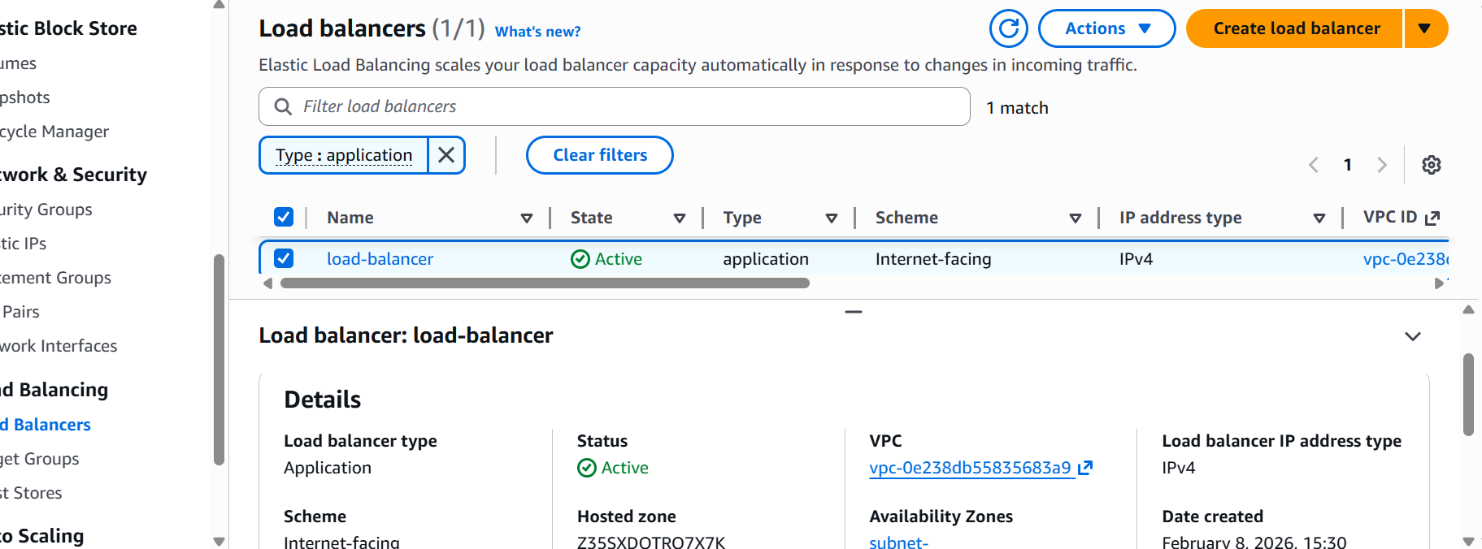

Slide 4

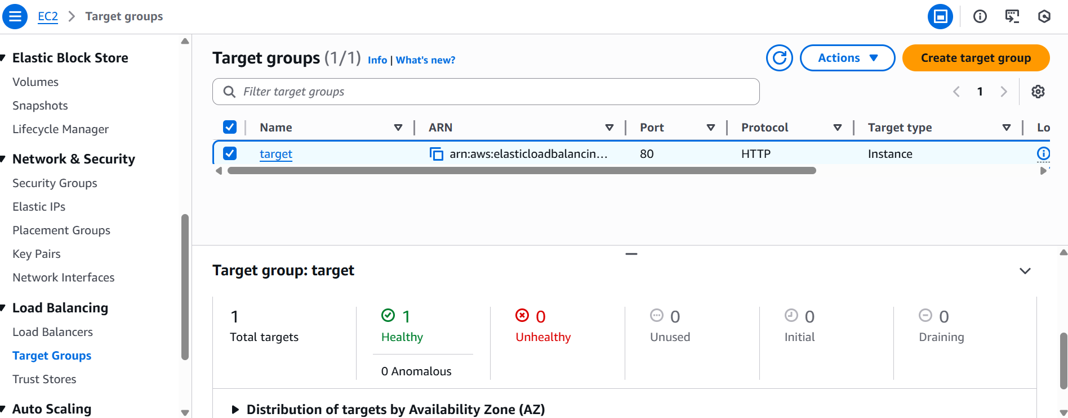

Slide 5
